Slide 1

Stock Market Indexes

Slide 2
The Oklahoma Department of Securities Invest Ed® program has provided this information as a service to investors. Invest Ed does not recommend any particular investment strategy or plan, any type of product, or any securities professional over another. No part of Invest Ed shall be taken as investment and/or legal advice.

Slide 3
Stock Market Indexes
Nasdaq
S&P 500
The Dow
Notes:
.
INFORMATION FOR THIS SLIDE: When we want to know how the stock market is performing, we need to look at a stock market index. A stock market index represents the value of a collection, or basket, of stocks.
The three most popular indices are the S&P 500, the Dow Jones Industrial Average, and the Nasdaq Composite.

Slide 4
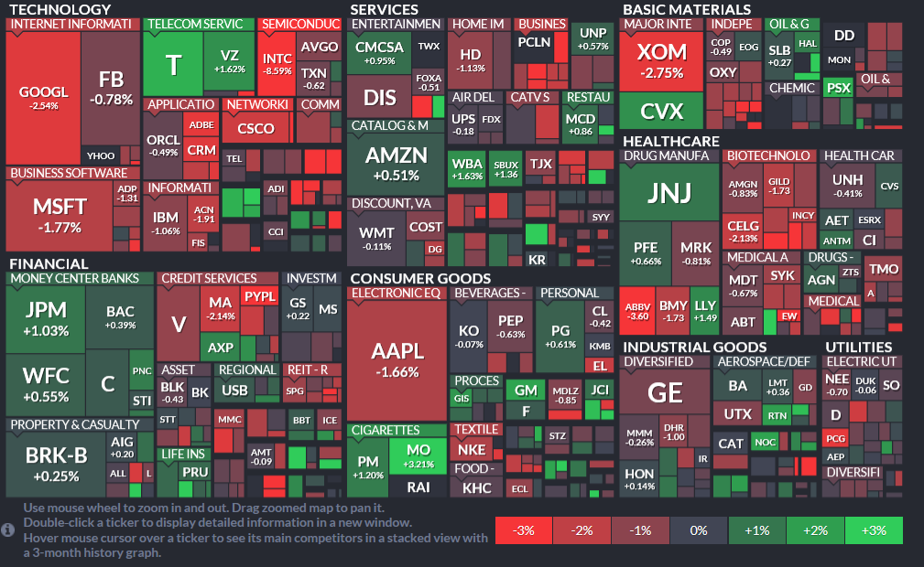
S&P 500
An index of 500 mostly large-cap companies from all the economic sectors.
Notes:
The Standard and Poor’s (S&P) 500 index, has 500 stocks, as the name suggests. It is a representation of the United States economy; as such, only US-based companies are included. This index holds primarily large-cap companies from all the economic sectors—technology, consumer goods, financials, etc.
The index is updated from time to time to better reflect the US economy; for example, steel and coal stocks used to be a big part of the economy and technology was a small part, but in the modern economy, technology has a large role, and therefore more and more tech stocks have been added to the index in recent years. Steel and coal stocks have a much smaller part in the index.
On this slide is a map of the S&P 500 Index from Finviz. Each box represents one company in the index; the size of the box depends on the relative market capitalization of each firm. The larger the company, the bigger the impact on daily changes in the index.

Slide 5
The Dow
This is the oldest index and is made up of 30 diverse U.S. industries.
Notes:
The Dow Jones Industrial Average, also known as “the Dow”, is a stock market index that includes 30 stocks. It is the oldest of the popular indices. Established at the turn of the 20th century, the Dow originally consisted of heavy industry stocks, but today has a diverse collection of US industries. There are periodic changes in the index membership. In fact, the last original member of the index, General Electric, was removed in early 2018 and replaced by Walgreens.

Slide 6
NASDAQ Composite
Is an index heavily weighted with technology companies and is used as a proxy, or representation, for the technology industry.
Notes:
The NASDAQ Composite consists of companies listed on the NASDAQ stock market. The index is heavily weighted with technology companies and is used as a proxy, or representation, for the technology industry.
These three indices can be tracked by most major financial websites, such as Yahoo Finance or FinViz.

Slide 7
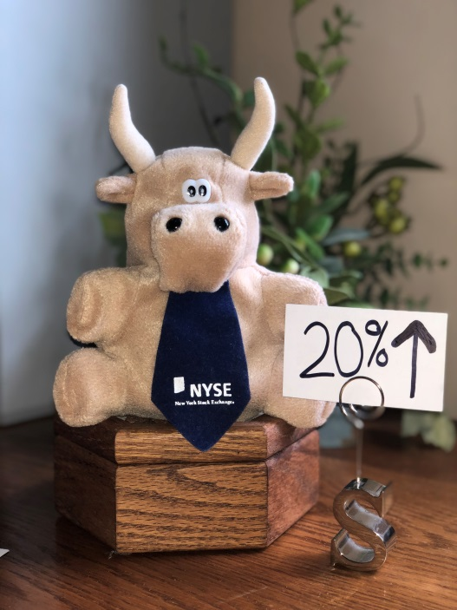
Bullish Market Trend
(Bull Market)
Occurs when the market index prices rise 20% or more over a recent low
Notes:
When referring to the stock market, a writer or commentator may describe current trends as “bearish” or “bullish”. Bearish trends indicate falling prices, bullish trends indicate rising prices.
The most commonly accepted definition of a bull market is when prices are 20% higher than the most recent low. For example if the SP 500 reached a low of 1500 two months ago, and prices rise to 1800, one could say that we are now in a bull market.

Slide 8

Bearish Market Trend
(Bear Market)
Occurs when market index prices fall 20% or more below a recent high
Notes:
A bear market is the opposite; it occurs when prices fall 20% from the recent high point in the market.

Slide 9
Terms
Market Index
S&P 500
DOW
NASDAQ Composite
Bull Market
Bear Market
Notes:
Key Terms –Stock Market Indexes
Market Index
S&P 500
DOW
NASDAQ Composite
Bull Market
Bear Market

